Slide 1
Computer Networks Fall 2023
Programing Assignment
4. Network Layer Assignment
Hou Huawei
1136288430@qq.com
Zhixin Building N201

Slide 2
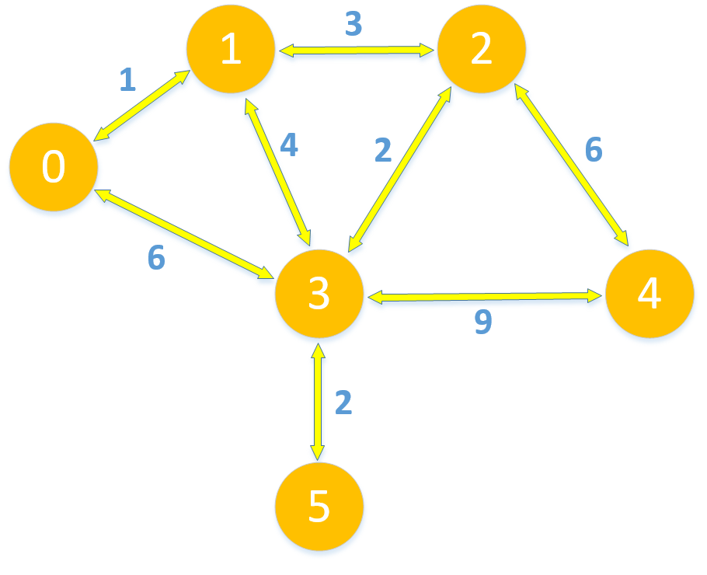
Content
Calculates the distance and path of a given topology.

Slide 3
Assignment 3.1 Dijkstra algorithm
Assignment 3.1: Dijkstra algorithm.
In this assignment, you will develop a Dijkstra algorithm in Python. You should write python script to develop it.
For the program:
Input a topology of network nodes and a specified node.
Output the distance list and path from the specified node to other nodes.
Be able to compute distance and path of any node in topology.

Slide 4
Assignment 3.2 Distance-Vector
Assignment 3.2: Distance-Vector algorithm.
In this assignment, you will develop a Distance-Vector in Python. You should write python script to develop it.
For the program:
Initialize the routing table for each node, and begin to iterate.
Output the distance list and path from the specified node to other nodes.
Be able to compute distance and path of any node in topology.

